Slide 1


T level Digital production, design and development
Lecture 01 - introduction

Slide 2
Who am i?
Degree (level 4 & 5)
BTEC
Level 4 apprenticeships
Industry experience
Programming
John Glazebrook
johng@truro-penwith.ac.uk

Slide 3
T level Digital production, design and development
Level 3 qualification
(Same as A Levels, BTECs and Apprenticeships)
2 years
Year 1:
Paper 1, Paper 2, Core Project
Year 2:
Project
315 hours of industry placement

Slide 4
Progression jobs (££$$$££$£!!)
Software Development Technician
Junior Developer
Junior Web Developer
Junior Application Developer
Junior Mobile App Developer
Junior Games Developer
Junior Software Developer
Junior Application Support Analyst
Junior Programmer
Assistant Programmer
Automated Test Developer

Slide 5
Progression academic
Computer Games Programming BCs
Software Engineering BSc
Virtual Reality Design BA
Computing BSc
Digital Media Design and Development BSc
Computer Science BSc

Slide 6
Email me
Log in
Open outlook
Email me
Name, any other email addresses you have, other contact details
What you’d like to get out of this course
Any worries you have
John Glazebrook
johng@truro-penwith.ac.uk

Slide 7
Course Topics
problem solving
programming
emerging issues and impact of digital
legislation and regulatory requirements
business context
data
digital environments
security

Slide 8
What I am covering
Problem solving
Computational thinking
Algorithms
Programming
Data / coding
Emerging issues and impact of digital
Legislation and regulatory requirements

Slide 9

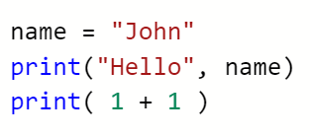
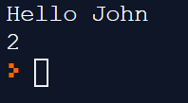
Python coding
We take it slowly.
I’m here and on email to help you.
Research and resources – books, online, e.g. youtube

